Slide 1
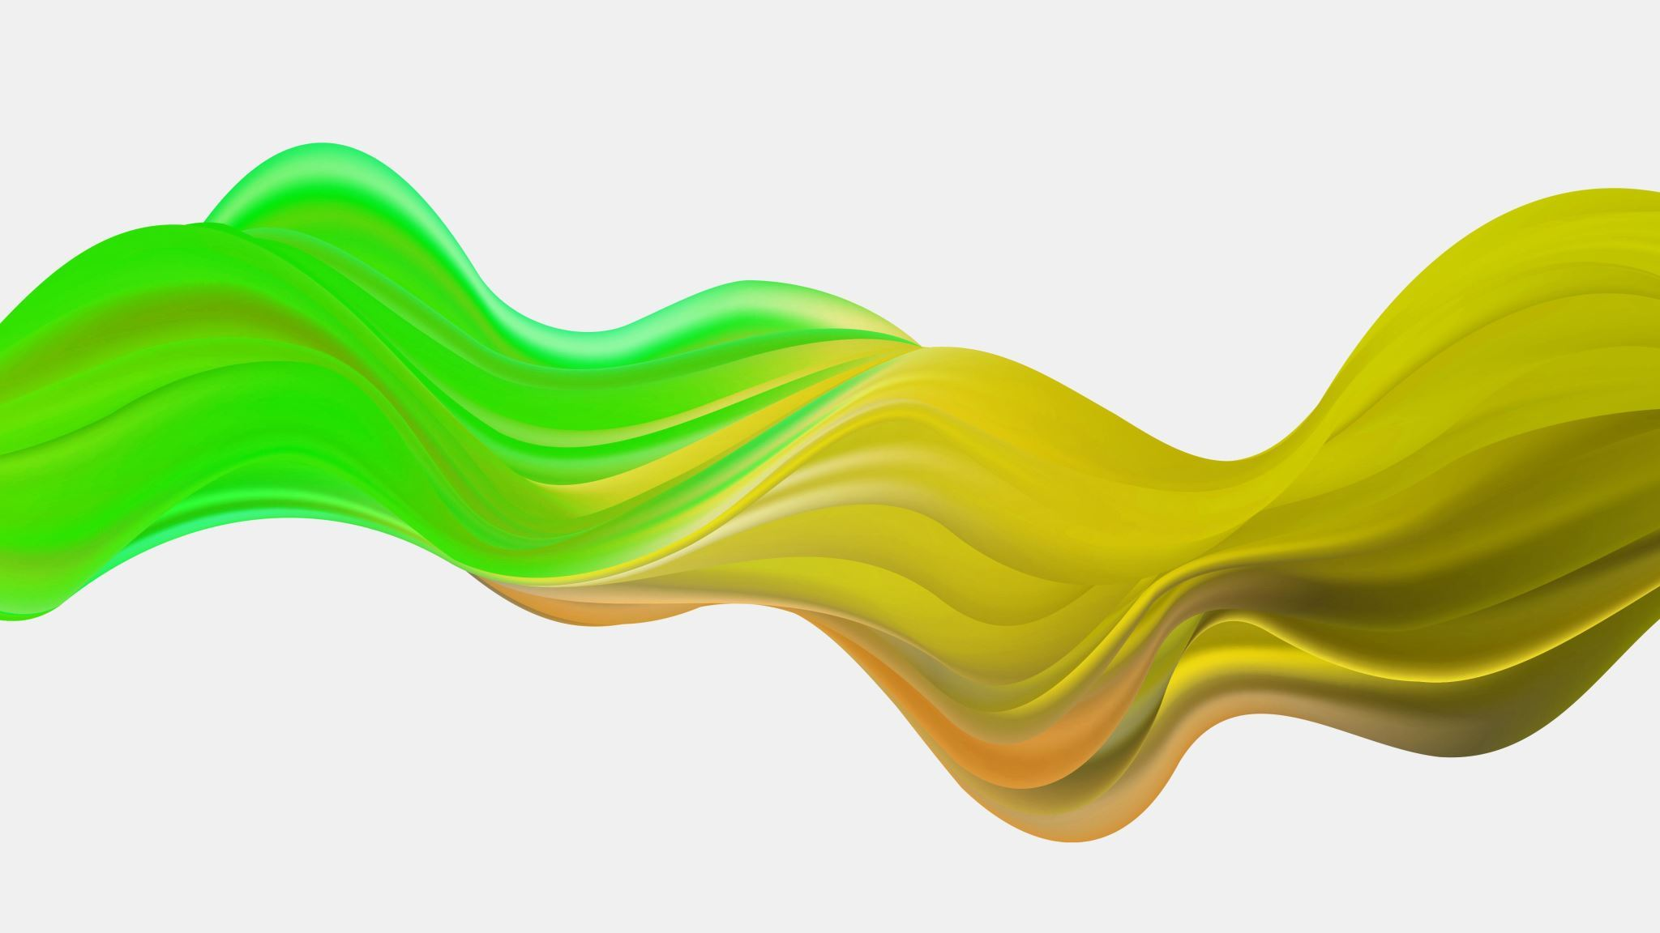
Virtual Desktop Infrastructure (VDI) Solution with Nutanix
Empowering Efficiency and Flexibility

Slide 2
CONTENTS
Our profile
Introduction to VDI
Overview of Virtual Desktop Infrastructure
Key Components of the VDI Solution
Benefits of the VDI Solution
Implementing VDI
Licensing, Costs, and Vendor Comparisons
Conclusion

Slide 3



Welcome To Our Company
Convergence IT solutions is Group of young and talented IT professionals who share a passion for achieving the very best in everything they do.
20+ Staffs on different departments
25+ Satisfied customers
100+ Partners world wide

Slide 4
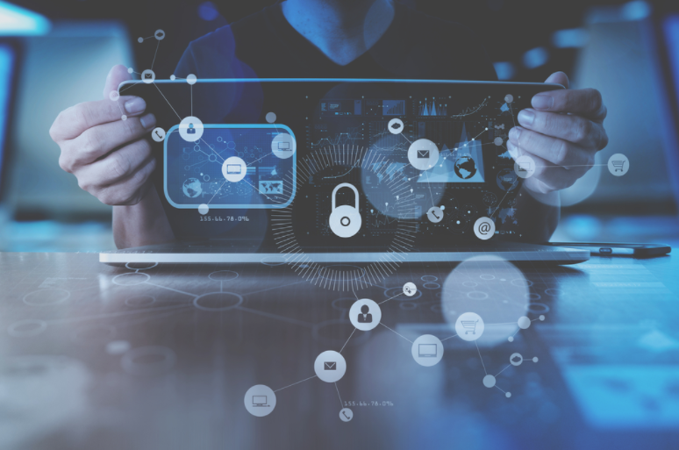
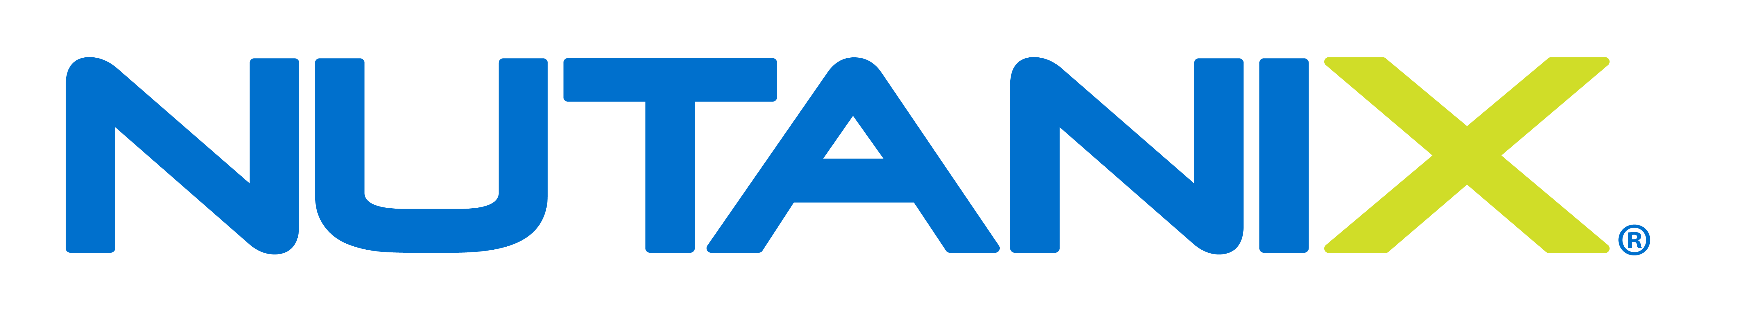
What is VDI solution ?
Virtual desktop infrastructure (VDI) enables organizations to deliver operating systems and applications in a centralized manner, without having to deploy a dedicated workstation for each employee. VDI solutions are based on desktop images, which a user connects to and uses as if it was running locally on their device. VDI solutions support a variety of endpoints including Windows, Linux and MacOS computers, mobile devices, or thin clients.
We will move all the apps and data to a secure dedicated and centralized data center with lots of shared compute and storage capacity. Then we give employee’s a remote access to those apps and data from wherever with whatever device. They can use laptops, tablets, PCs, phones e.t.c., whatever device that has at least some processing power and access to the internet.

Slide 5
Overview of Virtual Desktop Infrastructure
Virtual Desktop Infrastructure is a transformative technology that revolutionizes the way organizations manage and deliver desktop computing experiences
In a traditional setup, each user is equipped with a dedicated physical desktop or laptop

Slide 6
Traditional Workspace Challenges
Limited Mobility
Hardware Dependence
Data Security Concerns
Inconsistent User Experience
Scalability Issues
Limited Disaster Recovery Options

Slide 7
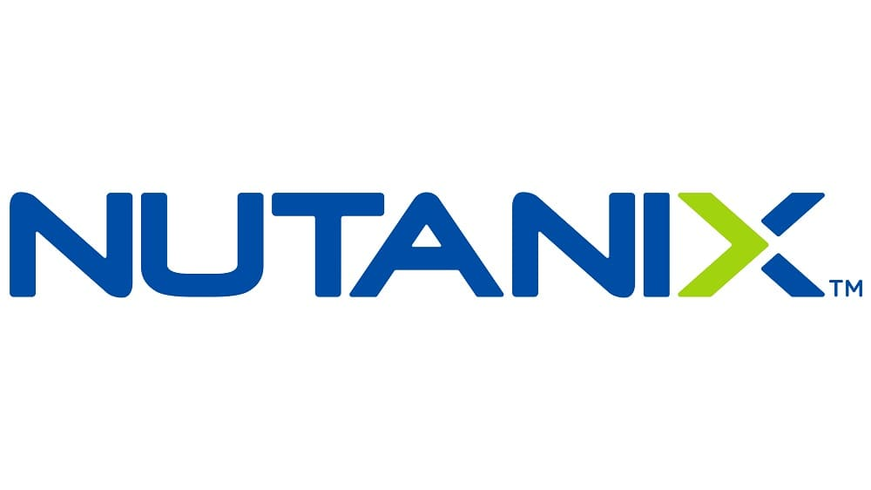
Nutanix VDI Solutions
Anywhere, Anytime Access
Hyper-Converged Infrastructure
Enhanced Security Measures
Consistent User Experience
Scalability with Ease
Robust Disaster Recovery
VDI centralizes desktop environments in a virtualized infrastructure, enabling users to access their desktops remotely

Slide 8

Key components of the VDI solution
Virtualization Platform
Hypervisor Technology
Connection Broker
Application Virtualization
Points of Access

Slide 9

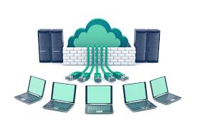
Virtualization Platform
A software component called the hypervisor creates the virtualization layer. It emulates physical resources and allows you to create multiple virtual machines (VMs) from a single server.
Hypervisor Technology
it is like an operating system or piece of software like Windows 10. It will be installed on a physical server that creates more virtual servers inside the physical server. The hypervisor can create hundreds of virtual servers.
Connection Broker
The connection broker manages user connections to virtual desktops
Application Virtualization
Application virtualization isolates applications from the underlying operating system

Slide 10

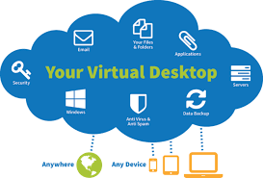
Why use VDI?
The world where office work happens almost exclusively at an office desk, via a company-issued desktop or laptop computer, is fast receding
Workers increasingly access applications remotely, as a service, either from the enterprise datacenter or from various cloud providers
Whether the organization has 50 or 100,000 employees, it is difficult and expensive for IT to keep all end-user devices maintained, updated, and connected to vital applications and resources

Slide 11
benefits of VDI
Centralization
Flexibility
Security
Simplification
Maximize performance
Support remote workers

Slide 12

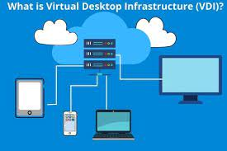
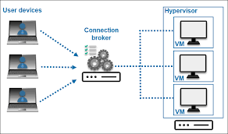
How Does VDI Work?
Users connect to virtual desktops via the connection broker. It authenticates each user and directs it to a virtual desktop instance. Once inside, users utilize a replica of the master desktop. The master desktop stores all the required applications and distributes it via application virtualization.
All virtual desktop instances are hosted on virtual machines. The VMs are created and managed by the hypervisor, the main component that provides virtualization of the entire system. Virtual desktops can be grouped into desktop pools which ensures easier management and configuration.

Slide 13

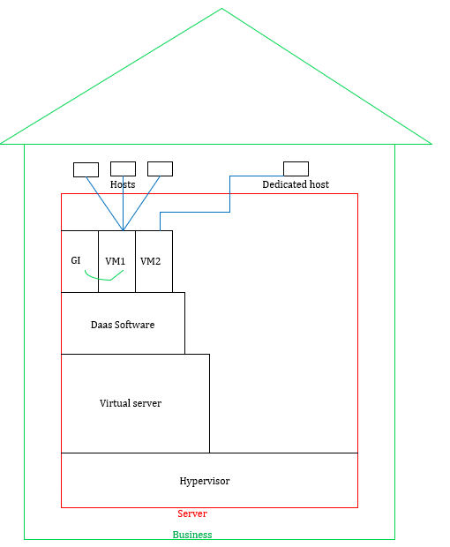
Implementing VDI
Hypervisor: it is like an operating system or piece of software like Windows
Daas: It is installed inside the virtual server
Golden Image: It is created inside the Daas software
VM1: It is created from the Daas software
Hosts: they are outside the physical server
Dedicated host: for users who utilize a lot of compute, for instance, who use AutoCAD or do a lot of Photoshop or videos, they will not share VM1; instead, they will use VM
This Photo by Unknown Author is licensed under CC BY-NC-ND

Slide 14

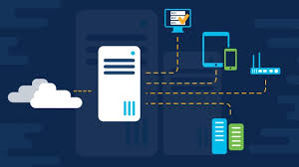
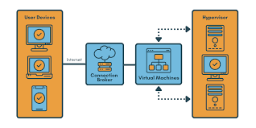
Persistent vs non-persistent VDI deployments
VDI can be deployed in two essential modes:
Persistent
Non-persistent
The advantages of persistent VDI include the ability to customize the desktop for the user’s individual preferences. The personalized nature of persistent VDI also lends itself to greater usability. The user is more familiar with the desktop, so it’s easier to use. Desktop management also becomes easier, as the persistent desktop can be administered in the same way as physical desktops.

Slide 15

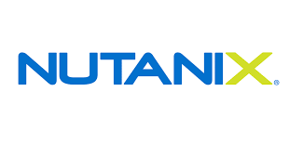
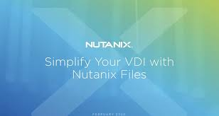
why choosing Nutanix
Hyperconverged Infrastructure
Nutanix offers a robust HCI solution that combines compute, storage, and networking in a single, integrated platform
Scalability and Flexibility
Nutanix scales seamlessly as your organization grows
Integrated Management
Nutanix Prism Central provides a unified management interface
You can manage multiple clusters across different locations from a single pane of glass
Customer Support and Community
Nutanix provides excellent customer support and a vibrant user community
Data Protection and Resilience
Performance and Efficiency
Strong Ecosystem and Partnerships

Slide 16

Licensing Models
Nutanix offers various licensing models for VDI, including per-user, per-device, or concurrent user licenses
Each model comes with its own set of advantages and may be tailored to fit the specific needs of your organization

Slide 17

Cost Considerations
This includes upfront hardware costs, software licensing, ongoing maintenance, and operational expenses
Conduct a thorough analysis to calculate the TCO over the expected lifespan of the solution

Slide 18


Conclusion
Virtual Desktop Infrastructure benefits your security, continuity, and accessibility needs. Your IT department will appreciate the level of security and central management. Your employees will love the ease of access, anywhere and on any device. As opposed to the on-premise solutions of the past, a hosted solution is cheaper and does not come with any upfront fees, while the hardware behind it can support even graphically intensive workloads.

Slide 19

CONVERGENCE IT SOLUTIONS
THANK YOU

